Slide 1
MY NAME IS FIRDAUSI HASSAN
TOPIC:EFFECT OF BODY IMAGE ON TEENAGERS “SELF ESTEEM”
HAVE YOU EVER WONDERED WHY MANY NIGERIAN YOUTH AND TEENAGERS WILL GO EXTREME TO LOOK LIKE WESTERNERS BY BLEACHING OR KEEPING LONG HAIR?

Slide 2
DEFINATION OF BODY IMAGE
BODY IMAGE PLAYS A MAJOR ROLE IN TEENAGERS “SELF ESTEEM”, MENTAL HEALTH AND OVER ALL WELL BEING. WEATHER THEY PERCEIVE THEM SELF AS “FAT OR SLIM, TALL OR SHORT, THERE SELF IMAGE CAN BE INFLUENCE BY CERTAIN FACTORS SUCH AS: SOCAIL MEDIA EXPECTATIONS AND PEER PREASURE.

Slide 3
NEGATIVE EFFECT OF BODY IMAGE (FELLING TOO FAT)
Many teens, especially due to media and social pressures, struggle with feeling over weight even when they are within a healthy range this can leads to:
1-low self esteem: teens who perceived themselves as overweight may feel unattractive or unworthy.
2-Mental health issues: increased risk of anxiety,depression,and eating disorder like binge(rapid or excessive consumption of food)or bulimia(chronic eating disorder).
3-social with drawal:fear of judgment may lead to avoiding social situations.
4-unhealthy dieting habits: some resort to extreme dieting,fasting,or over-exercising leading to physical harm or using dieting pills to loss weight.

Slide 4
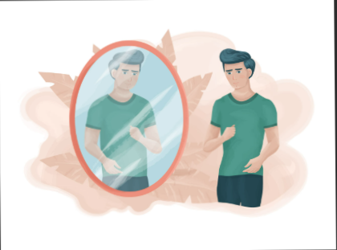

Slide 5
NEGATIVE EFFECT OF BODY IMAGE (FELLING TOO SLIM)
Some teens, especially boys feels self-conscious about being too thin.
Body Dysmorphic: An obession with gaining muscle or weight, often seen in muscle Dysmorphia
Use of supplement/steroids: some teens resort to unhealthy method like excessive protein intake or steroids to bulk up
Bullying/teasing: Being called “too skinny” or weak can damage self esteem and social confident.

Slide 6
POSITIVE BODY IMAGE(SELF ACCEPTANCE AND CONFIDENT)
A healthy body image leads to:
Higher self-esteem: teens feel comfortable in these skin and less pressured by unrealistic beauty standards.
Healthier habits: They are more likely to eat well, exercise for fun and well-being, not just to change their body.
Better mental health: Less anxiety, stress and depression related to body concerns

Slide 7
HOW TO PROMOT A POSITIVE BODY IMAGE IN TEENS
Encourage self love: Focus on strength beyond appearance
Promote healthy good model: Expose teens to diverse and realistic representation.
Limit social media pleasure: Teach media literacy to understand unrealistic protocols
Support healthy habits: Exercise and eat well for over all wealthy, not looks.

Slide 8
CONCLUSION
There are things we can change and there are things we cannot change. We must learn to accept and celebrate what we can not change which include our body image. People need to thank God on what he gave them, remember that some people wish to have what you have so always be contented.

Slide 9
THANK YOU
BROUGH TO YOU BY FIRDAUSI HASSAN

